Slide 1

All Teachers are Language Teachers
Supporting your ELs in All Content Areas
Notes:
You all know that you teach the language of your subject area, but have you ever thought of yourself as a language teacher?

Slide 2
OBJECTIVES
Understand the “Why and How” of incorporating Language into all lessons
Identify the three dimensions of academic language
Create Language Objectives for your Content
Notes:
Read objectives

Slide 3
Why Do I have to Incorporate Language?
ESSA and TN Policy
Increased collaboration
Increased accountability for all teachers who serve ELs and Transitional Students
Intentional Scaffolds/Supports for all Students
Notes:
Why? This is not Cordova High policy or SCS policy; This comes from the ESSA law and the state of Tennessee. It is a way of formalizing what you already do.

Slide 4

TN English as Second Language Program Policy
All teachers providing instruction to EL students shall be trained on the WIDA English language proficiency standards.
Notes:
https://www.tn.gov/content/dam/tn/stateboardofeducation/documents/policies/3000/3.207%20ESL%20Program%20Policy%2010-20-17.pdf
By state policy all teachers must be trained in ESL standards. This training today covers the required training for you for this year.

Slide 5

Individual Learning Plans
An individual learning plan (ILP) is a document that describes the academic and language needs of, and goals for, an English learner (EL). An ILP details the strategies, accommodations, and goals to be implemented daily in the classroom in order to help ELs be successful.
Notes:
You do not have ILPs for your students yet this year because we have a new format that was taught to us just a couple of weeks ago. (As you all know when things are changed, it takes a while for them to roll out. Be patient. We’re working on it.)

Slide 6
Why are Policy and the ILP Important
Supporting
supporting language acquisition across the instructional day
Providing
providing meaningful participation in core instruction
Enabling
enabling students to reach grade-level targets in their academic subjects
Coordinating
coordinating instructional approaches, including collaboration, among all educators

Slide 7
Language Demands of Everyday Learning in Core Classrooms
Receptive Language |  | Productive Language
Listening | Reading | Speaking | Writing
Listen to an understand teacher talk about academic concepts and texts Listen to and understand peers in collaborative tasks. | Read to understand the literal meaning of texts and task directions Read to research and learn new concepts and content. Read critically to make inferences. | Speak to express thinking about academic topics, concepts, and texts. Collaborate with peers to problem solve, research, and create. | Write to communicate thinking about content topics, concepts, and texts. Collaborate to create and edit.
Notes:
This chart shows what language is used for in the classroom & divides it into receptive and productive language.

Slide 8
How Does our Data Reflect our Support of Language Learners in All Content Areas
2018 WIDA Proficiency Results
SCS | Mean Listening Proficiency | Mean Reading Proficiency | Mean Speaking Proficiency | Mean Writing Proficiency | Mean Comprehension Proficiency | Mean Oral Proficiency | Mean Literacy Proficiency | Mean Composite Overall Proficiency | Mean Composite Overall Proficiency Growth from Previous Year | Percentage of Students Meeting 2018 Growth Standard | Students with Valid 2018 Results | Students with a Valid 2018 Growth Score
1.00 | 4.53 | 3.39 | 2.93 | 3.20 | 3.82 | 3.58 | 3.20 | 3.29 | 0.45 | 48.42 | 8,278 | 5,894
CORDOVA HIGH SCHOOL | 3.88 | 3.45 | 2.39 | 3.61 | 3.58 | 2.94 | 3.51 | 3.30 | 0.23 | 32.52 | 162 | 123
Notes:
Take a minute to look at the data for your school
What do you notice? Note ≤ 3.0 is beginning level - not proficiency
What does this suggest about instruction?

Slide 9
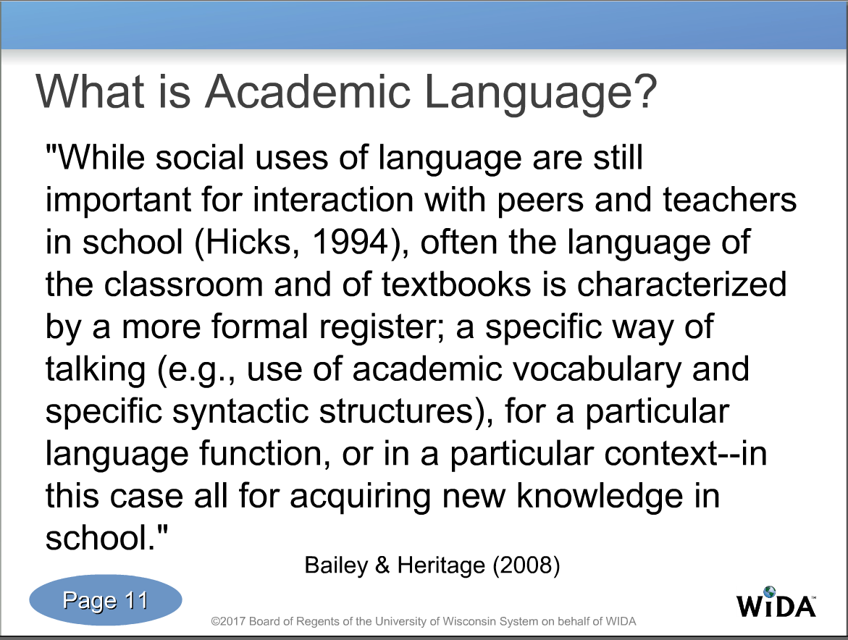
Focusing on Academic Language
Notes:
This is a definition of academic language. A lack of academic language across content is what keeps our students from growing on TNReady and WIDA

Slide 10
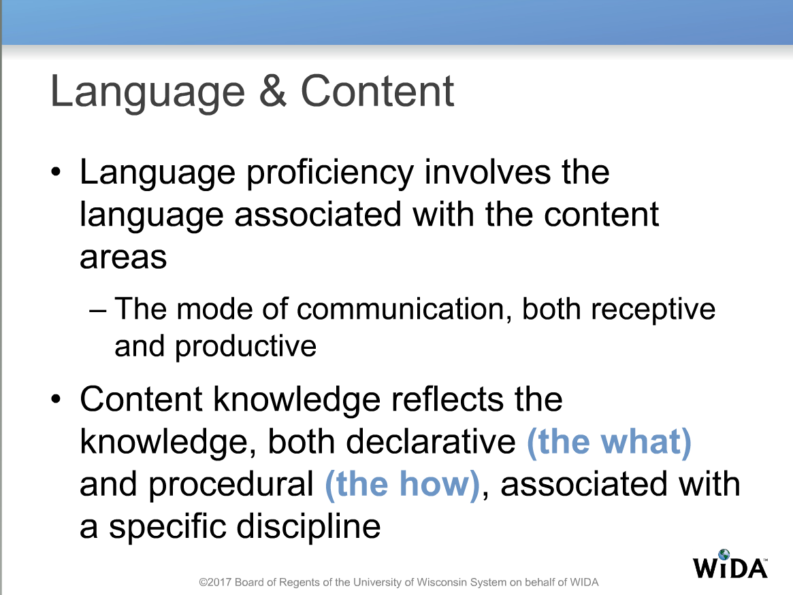
Notes:
This shows that there is a relationship between language proficiency and content knowledge. The two go hand-in-hand.

Slide 11
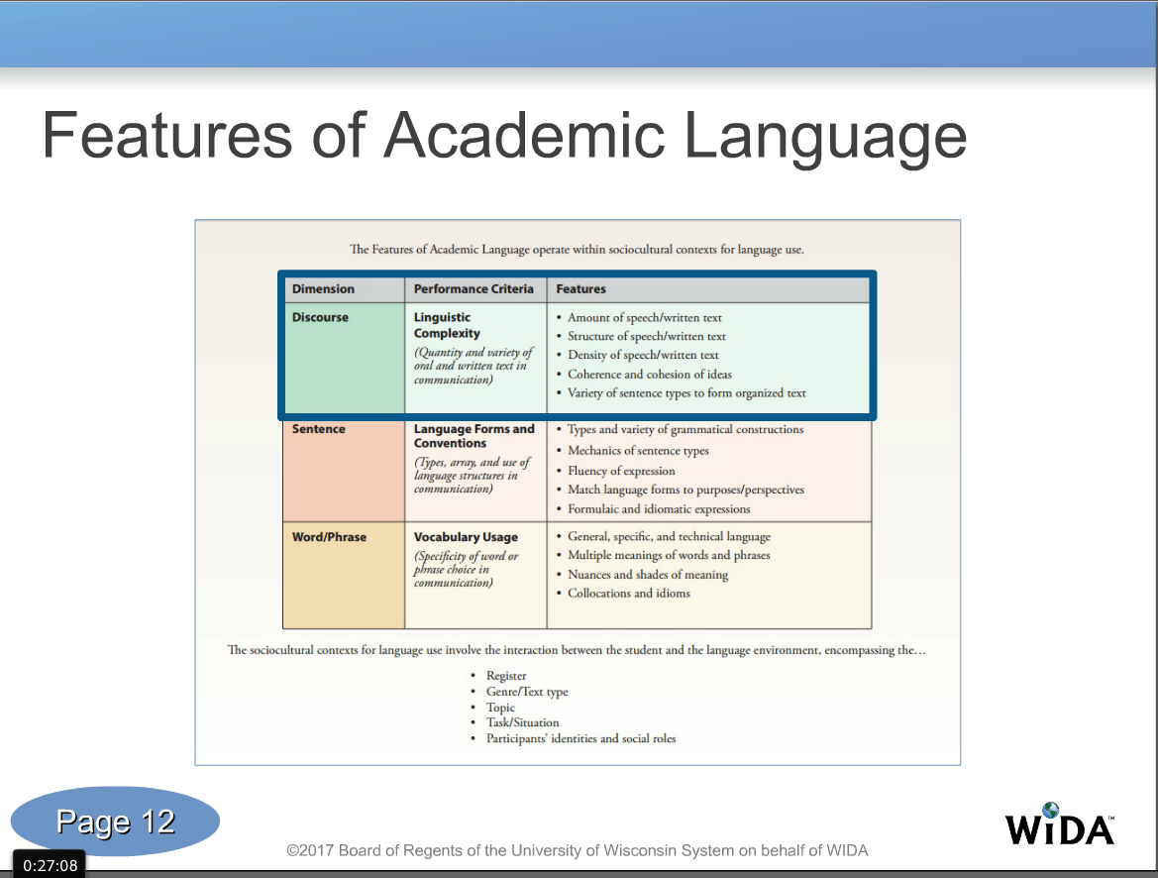
Notes:
How much, what kind, how difficult, what type…

Slide 12
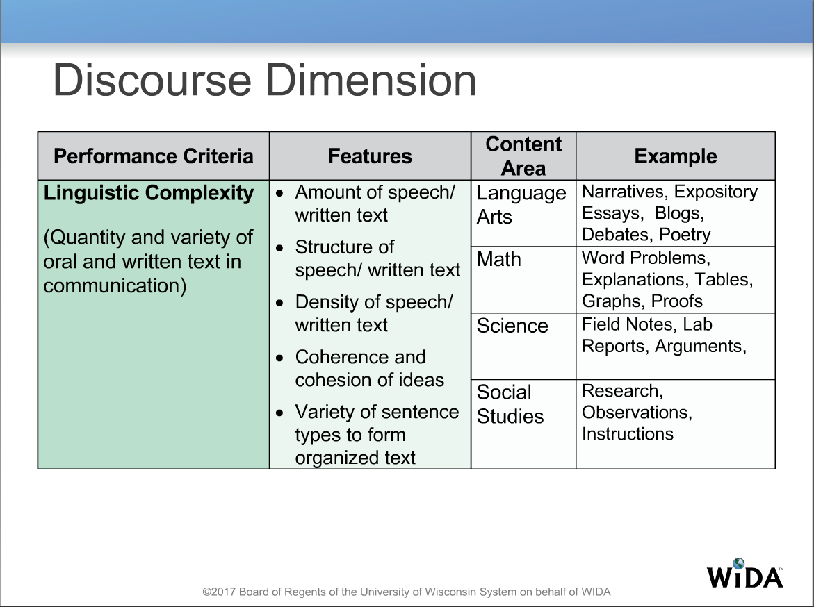
Notes:
What are the opportunities in your content to build discourse around your content? Talk among your table.

Slide 13
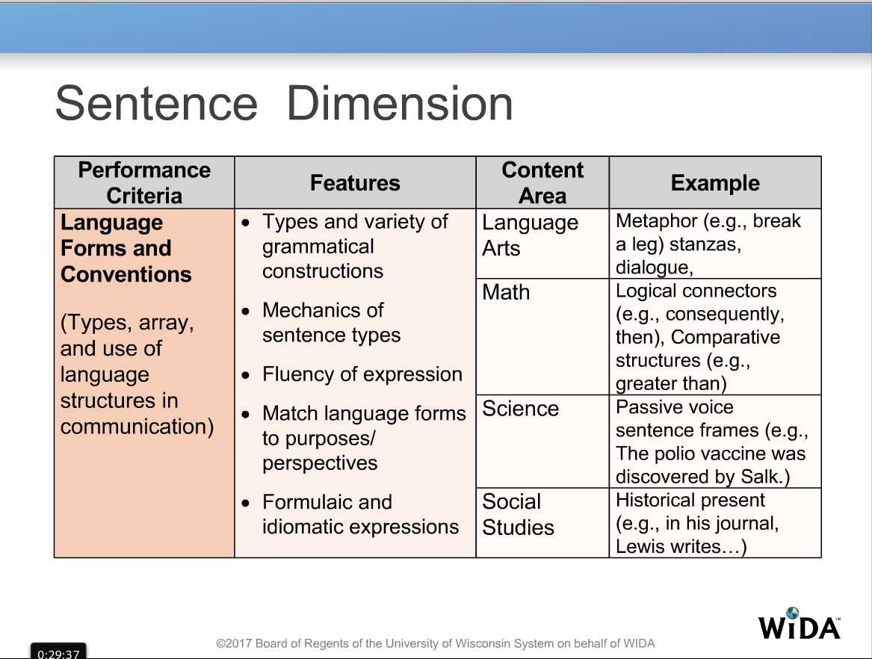
Notes:
What words could you add to an interactive word wall/note book to support all of your students
What words would you use to create a sentence frame?

Slide 14
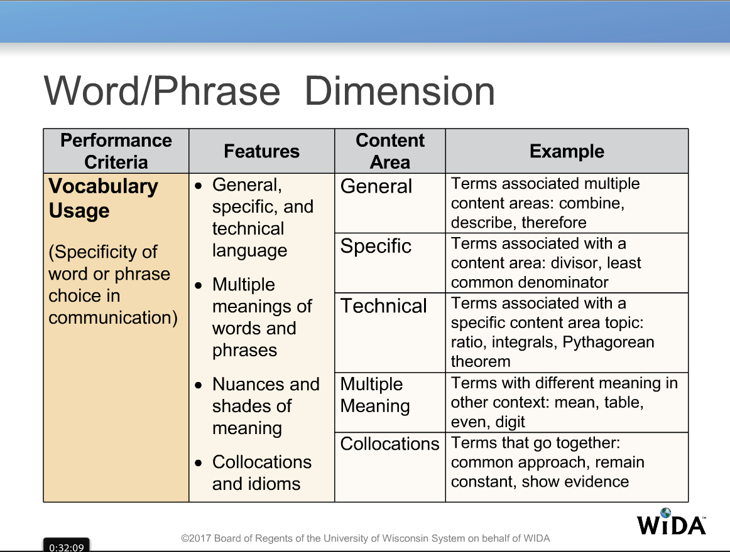
Notes:
What words in your content area might be confusing for an EL?

Slide 15
What do I need to begin?
WIDA Standards Resource Guide (Content)
Language(Reading, Speaking, Listening, Writing)
Information on students you are teaching! (Scaffold)
Notes:
WIDA has only 5 standards:
The language of language arts; math, social studies, and science… This is your content The standard you’re not seeing here is social language.

Slide 16
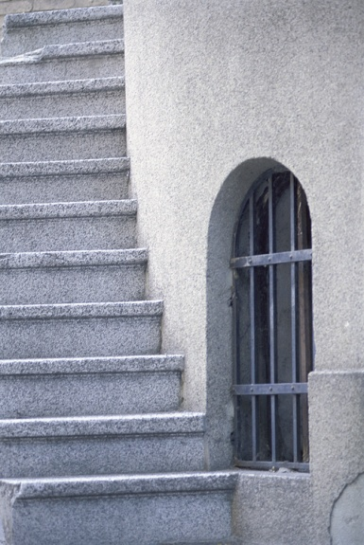

Steps to Incorporating Language
Look at your Daily Target (the standard)
Choose domain(s) to address (R,W, L, S);
Add a scaffold
Use with students!
Notes:
Hint-this is done for you within your curriculum

Slide 17
Let’s Look at ELA
Grade 9 ELA
Target
Read and summarize key points from text that provide historical background knowledge. (9-10.RL.KID.2)
Determine a theme or central idea of a text and analyze its development over the course of the text; provide an objective summary of the text.
Notes:
Here’s an example of and 9th grade ELA standard and the day’s learning target.

Slide 18
Content: I can read and summarize key historical information on p. 1040A-1040F “Preparing to Read the Odyssey.”
Language Objective:
I can read with a partner for historical information using a word box and highlighting historical facts. I can summarize the facts using sentence frames.
Notes:
Green – Wida standard/yellow – learning target/blue-scaffolds .You have now added language and scaffolded for students.
The scaffold can be adjusted to fit the learner---Do the students only write words? Do they write sentences? To you use a word box?

Slide 19
And in Math
WIDA Standard (Content)- the Language of Math
A2.A.CED.A.1: Create equations and inequalities in one variable and use them to solve problems.
Language Objective: Students will write and solve equations and justify the solution path chosen by using a word box and step-by-step graphic organizer.
Notes:
Where are the opportunities for language in this standard?
What vocabulary could you focus on?

Slide 20
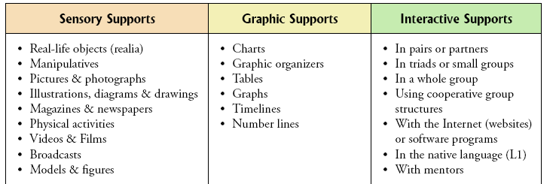
Examples of Supports:
Chosen to match language student needs!
from WIDA/ELP Resource Guide – RG 21
Notes:
Leave these up for the activity.

Slide 21
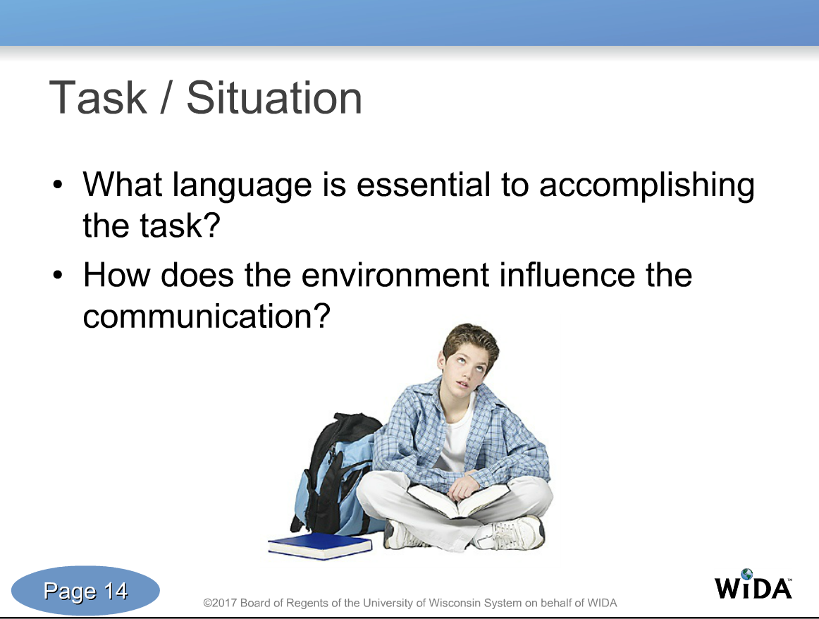
So Let’s Think About What Happens in your Class…

